Slide 1
Jokes or Not
Cloudy Liu

Slide 2
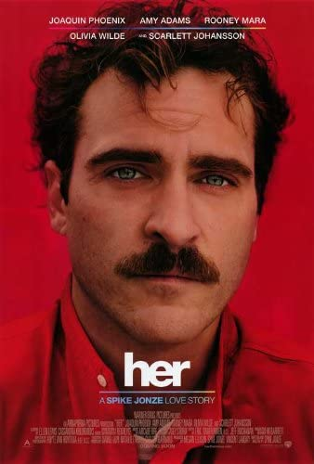
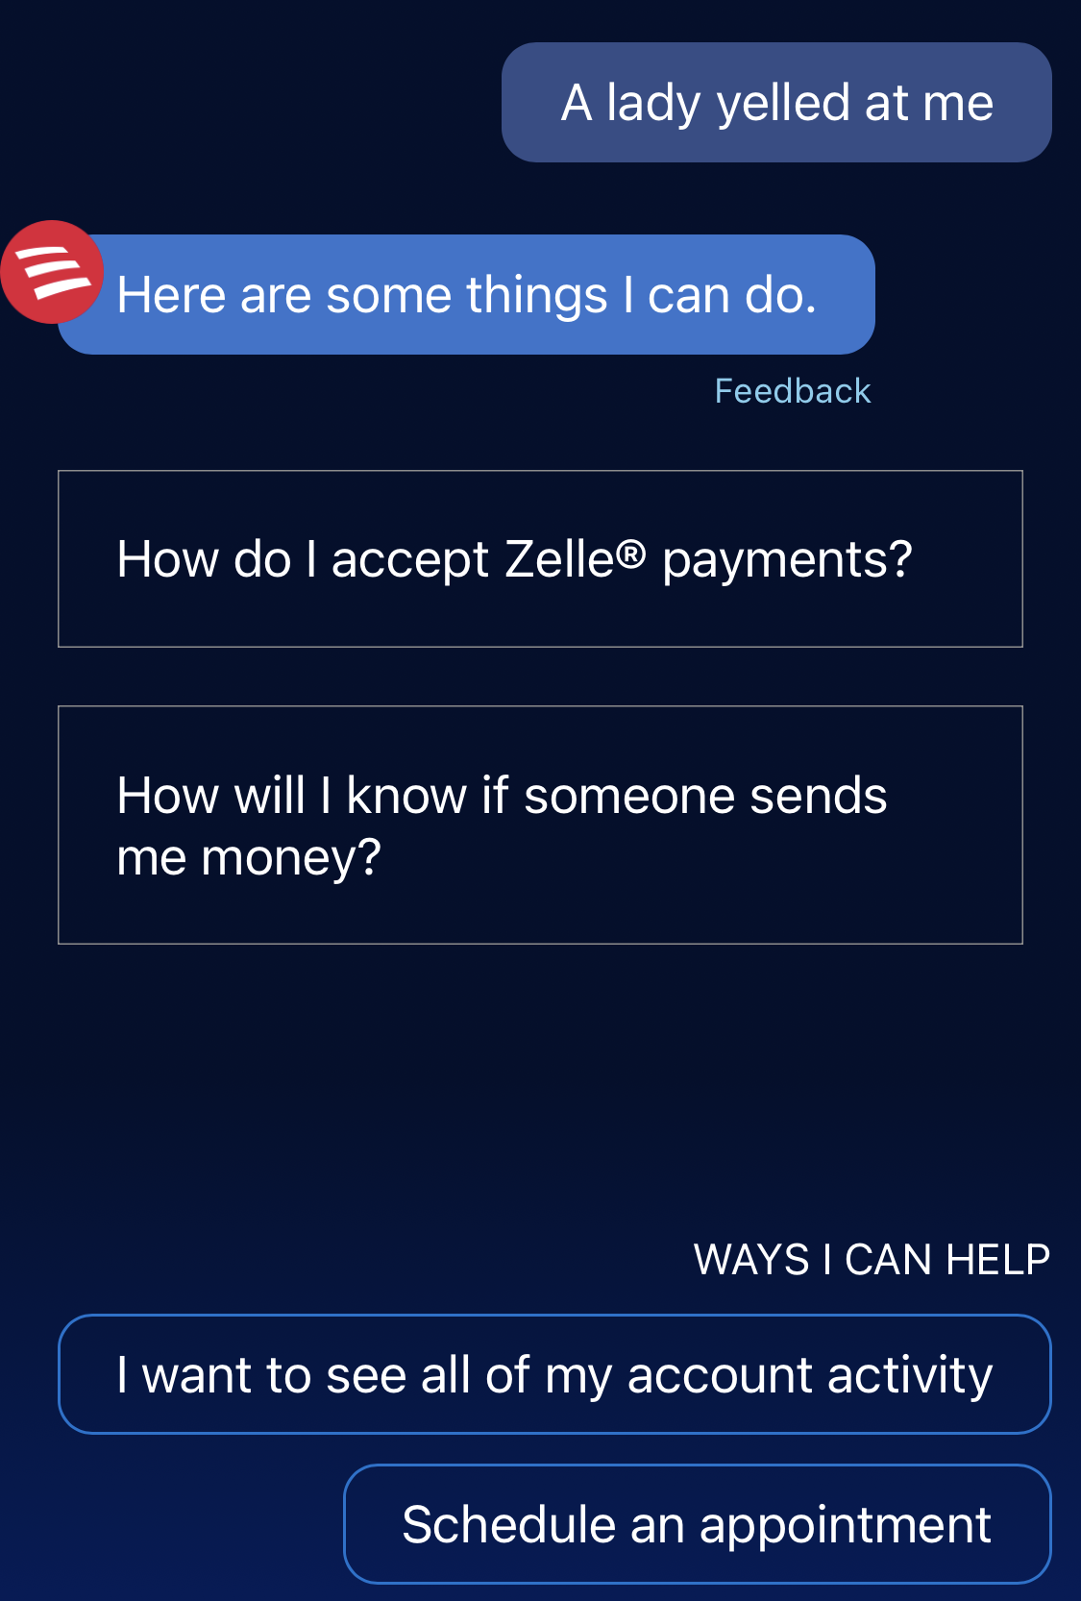
Ideal vs Reality

Slide 3
Problem Statement
To build a classifier that is able to tell an intended joke from the sharing of a personal story
To serve as a first step to give virtual assistants some personal touch during the communication with customers
So that to establish emotional bonds down the way
Audience: product managers at an online retail company

Slide 4
Data Selection
Subreddits: Jokes(19.4m) vs TalesfromRetail (604k)
Both could be very funny
However, one with an intention to entertain (punch line), the other was to share (loose structure)

Slide 5
Process
word count
age
20,038
18,953
Data Fetching
Initial Feature Selection
Data Cleaning
Feature Engineering
stop words
sentiment analysis
8 models
Conclusions
Evaluation
Modeling
EDA & Visualization
Pre
processing

Slide 6
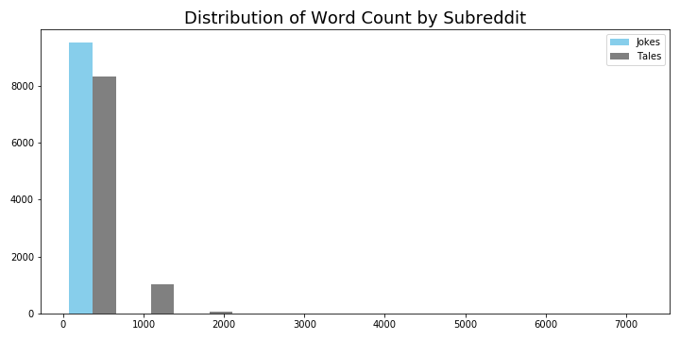
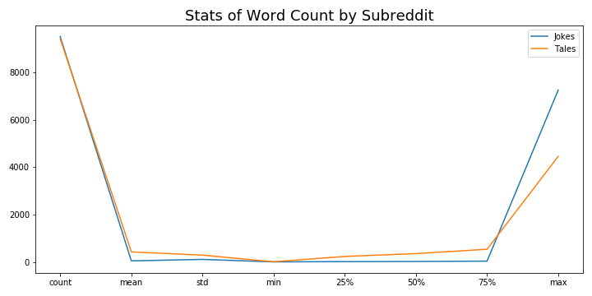
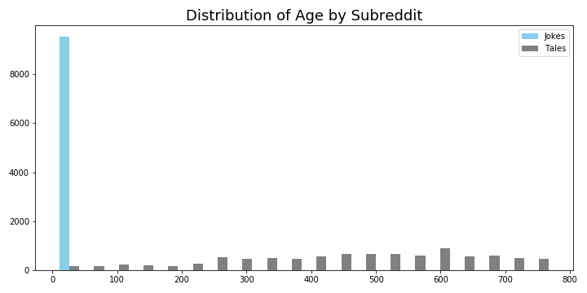
Exploratory Data Analysis

Slide 7
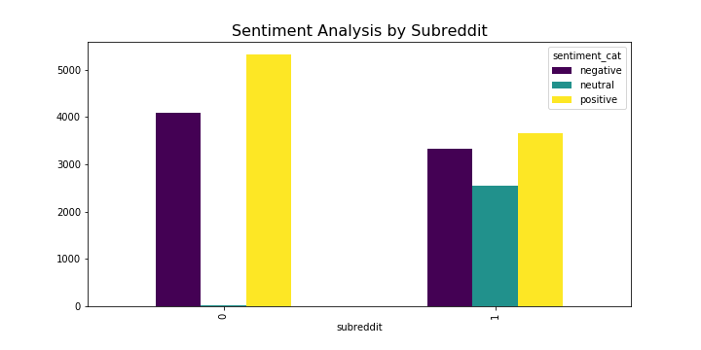
Sentiment Analysis

Slide 8
Model Goal Setting
What metrics do I care the most?
Specificity
You don’t want to make fun of people’s bad experience (rant/complaint…)
Accuracy
You want to say the right things to the right mood
Other factors?
Feature Numbers
Computational Costs

Slide 9
Model Comparison
% | Baseline | Logistic Regression | K-Nearest Neighbors | Naïve Bayes | Random Forest | Extra Trees
 | 50.2
CV |  | 99 |  | 92.5
TV |  | 98.5 | 93.6 | 93 | 98.3 | 97.8
10k, 4k
4k
2k
4k
4k
2k
2k

Slide 10
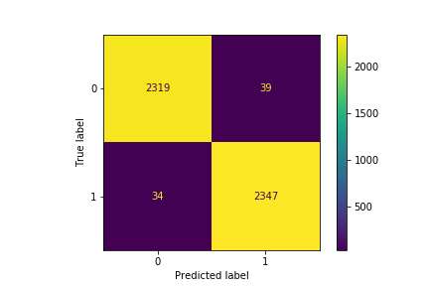
Best Model Selection
Logistic Regression with TfidfVectorizer
High Accuracy: 98.5%
High Specificity: 98.3%
Fewer Features : 2,000
Faster Run Time: 16min for 120 fits
Interpretability

Slide 11
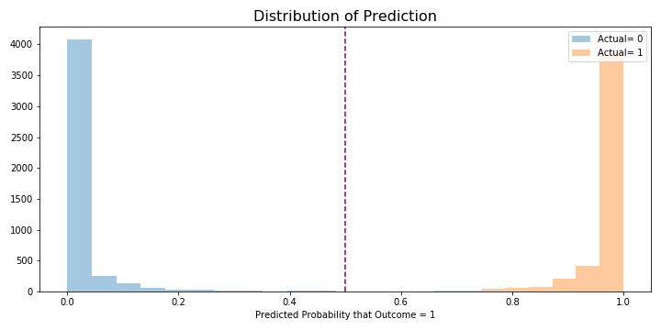
Evaluation

Slide 12
Jokes or Tales?
I was told to leave the grocery store. They said I was taking way too long at the self-checkout. It's not my fault........I didn't put the mirror there.
Easy Like Sunday Morning Customer: “Will you call me a cab?” Me: “Sure! You’re a cab! Who’s next, please?”
I run a small online store, we sell custom hair extensions. Client orders, to put it in her words "The blondest blonde you have to match my hair color that is really blonde you know like blonde blonde” So we dye the hair to lightest ash blonde, manufacture to specification and courier it out. Client sends an email "I'm soooo upset, I ordered blonde this is NOT blonde”. I reply that I personally did the color work, I know it was as blonde as possible, please send a picture of the item she received to make sure the right item was dispatched. She sends a picture of exactly the correct, lightest ash blonde item we make. Now I'm confused, need to understand this further and phone her. She answers and packs out laughing "What's wrong?" I ask, "Nothing, all good" she says. "Please I need to understand what was wrong with the color?” Then she answered with the blondest line I've ever heard. "I had my sunglasses on”
Jokes
Tales
Tales

Slide 13
Misclassification
r/TalesfromRetail as r/Jokes(39)
Positive: 23
Neutral: 0
Negative: 16
Avg word count: 125
Max word count: 309
r/Jokes as r/TalesfromRetail (34)
Positive: 16
Neutral: 10
Negative: 8
Avg word count: 178
Max word count: 1241

Slide 14
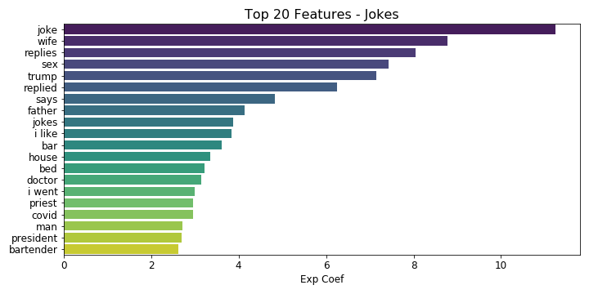
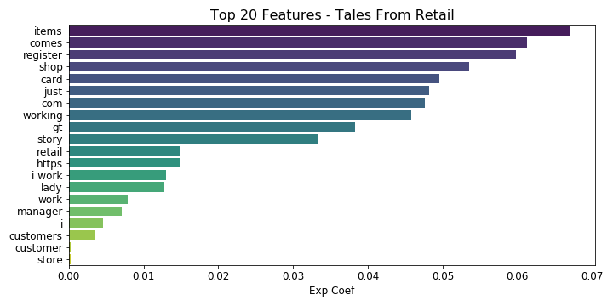
Significant Features
Role/Profession
Sexual
In-trend
Retail

Slide 15
Conclusions
The two subreddits are very likely distinctive enough;
Logistic Regression with TfidVectorizer provides the best model with high accuracy and high specificity. However it also tends to classify based on the length of the texts;
Sentiment analysis could be used as a tool to improve classification;
Key identifiers for Jokes: professions (”priest”, “doctor”, “bartender”, “president”), sexual(”sex”, “bed”, “wife”), trend words(“trump”, “covid”);
Key identifiers for TalesfromRetail: retail terms (“items”, “registers”, “customer(s)”, “manager”, “I work”).

